Slide 1
SYNOPSYS Digital Addressable Water Leak Detection System
Main Water Leak Detection Panel (SY3618)
Features:
1.Operates on 230 V A.C.
2. Provides supervision of Interface modules.
3. LCD display to indicate Module No. and distance to Leak Location in Meters .
4. 500 Event Logging.
5. RS485 Communication with Interface Modules.
6. Mod bus output for BMS Communication.
7. Built-In audible sounder and one Common Hooter Output.
8. Fault Relay output.
9. Common Alarm Relay Output.

Slide 2
SYNOPSYS Digital Addressable Water Leak Detection System
TECHNICAL SPECIFICATION OF WATER LEAK PANEL:
Supply Voltage : 230v AC 50Hz ± 10%
LCD Display : Backlit
Max. Modules to be connected : 64
Event logg :500
Audible : Sounder for alarm and fault
External hooter output : 24v DC
Fuse : 2 Amp
Working Temperature : 0 to 50 ° C
Construction : M.S Powder Coated
Weight : 5 Kgs Approx
Size ( H X W X D ) : 275x250x110mm

Slide 3
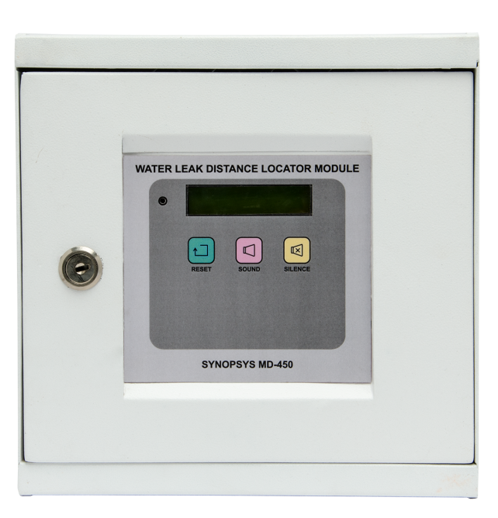
SYNOPSYS Digital Addressable Water Leak Detection System
Water Leak Interface Module (MD-450)
Features:
• Displays distance to leak location in meters.
Indicates Cable break condition.
Operates Potential free relay in case of Alarm and Cable fault for BMS Integration.
Maximum length of linear leak detection cable 150 mtrs.
Can detect leak any where along the entire cable length.
Built in audible sounder and common hooter output.
Easy to install and operate.
Self restoring.
Soft membrane keypad.

Slide 4
SYNOPSYS Digital Addressable Water Leak Detection System
TECHNICAL SPECIFICATION OF WATER LEAK INTERFACE MODULE:
Supply Voltage : 230v AC 50Hz ± 10%
LCD Display : Backlit
Max. Cable Length : 150 Mtrs.
Relay Leak and Cable break type : SPDT Single Contact NO-C-NC
Audible : Sounder for alarm and fault
External hooter output : 24v DC
Fuse : 2 Amp
Current Consumption Standby : 0.4 Amp
Current Consumption Alarm state : 1 Amp
Working Temperature : 0 to 50 ° C
Construction : Metal Enclosure wall mounted
Weight : 3 Kgs ( approx)
Size ( H X W X D ) : 250x250x110mm

Slide 5
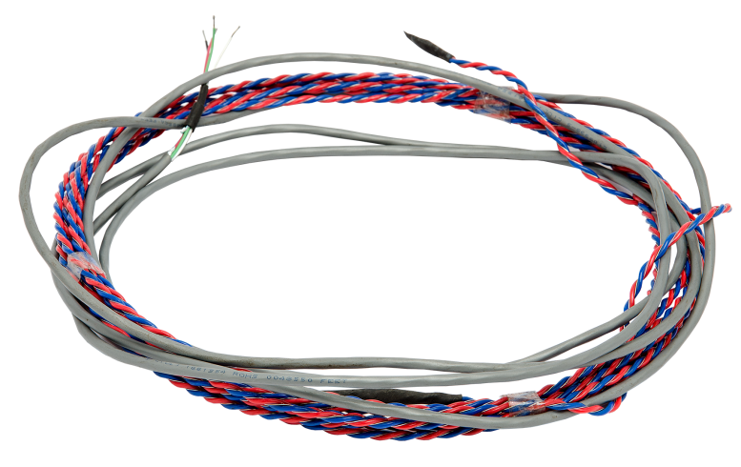
SYNOPSYS Digital Addressable Water Leak Detection System
ADDRESSABLE WATER LEAK DETECTION
CABLE ( WD-AS)
Features:
Water Leak Detection cable consists of four
conductors, two water sensitive and two data.
The cable is restorable and corrosion resistant
and does not require replacement after being
wet.
Cable can be installed in the path of a potential
water leak.

Slide 6
SYNOPSYS Digital Addressable Water Leak Detection System
TECHNICAL SPECIFICATION OF WATER LEAK DETECTION CABLE:
Material : PVC twisted pair with stainless steel 316
elements
Leader Cable : 3 mtrs
Dimensions : 3.5mm dia
No. of Wires : 4 – two water sensitive and two data sensitive
Max cable length : 150 mtrs
Std cable lengths : 10,15,20,25,30 and so on upto 150 mtrs.

Slide 7
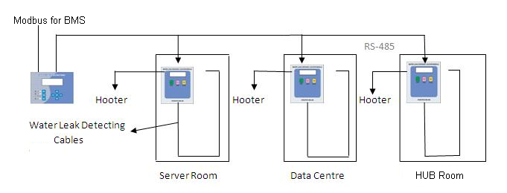
SYNOPSYS Digital Addressable Water Leak Detection System

